Slide 1
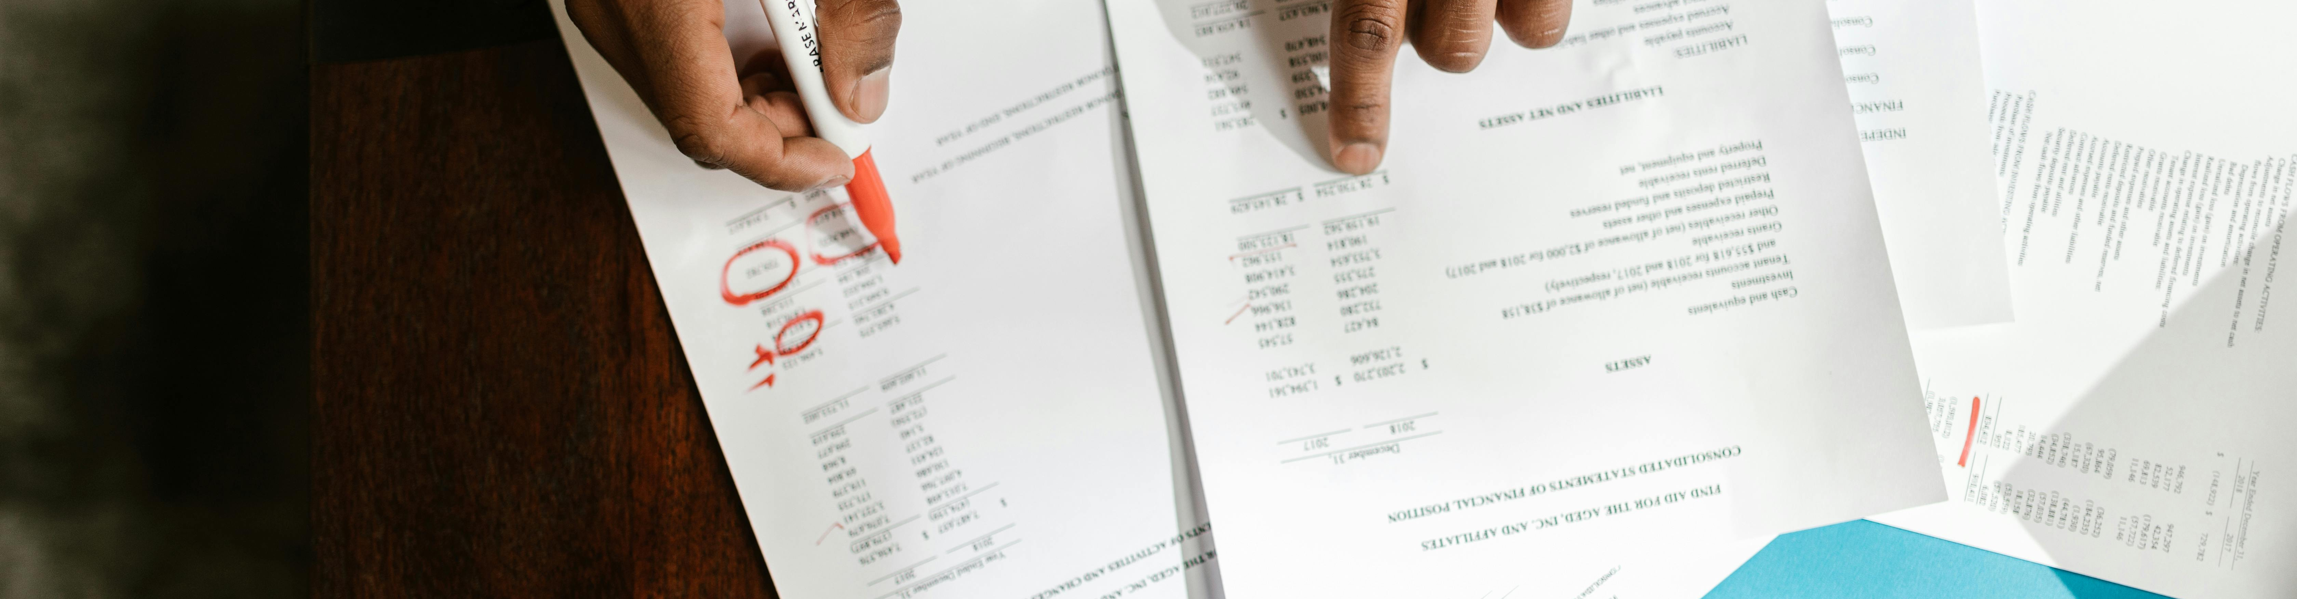
Parallel Simulation
Information Systems Auditing
Class XI

Slide 2
Class Recap

Slide 3
Class Roadmap
IT Governance: Concept
IT Governance: Audit Program
IS Acquisition and Development
IS Implementation
IS Operation & Business Resilience
Protection of Information Assets I: Part A
Protection of Information Assets II: Part B
Mid-Term Exam
Basic of Data Analysis
Risk and Control
Parallel Simulation
Analytics and Sampling
Substantive Testing: Sales Cycle
Substantive Testing: Expenditure Cycle
Audit Report
Final Exam

Slide 4
Covered So Far
Import data to spreadsheet
Do basic analysis using spreadsheet
Design and test (ToD) Basic AppCon
Basic examples of ToE using spreadsheet

Slide 5
Recap ToE
Konsep Simulasi Sejajar
Praktik!

Slide 6
Recap ToE

Slide 7

Who’s who 7-Audit-5
Tugas di-publish
Submission Pertama
Submission Terakhir
9 Februari 2026
10 Februari 2026
19:10:32
15 Februari 2026
1:41:51
NXXXXX
BXXXXXXXXXX

Slide 8
Who’s who 7-Sisfo-2
Tugas di-publish
Submission Pertama
Submission Terakhir
9 Februari 2026
12 Februari 2026
16:47:45
15 Februari 2026
23:44:01
JXXXXX SXXXXXX PXXXXXX HXXXXXXXXX MXXXXXXX

Slide 9
Konsep Simulasi Sejajar

Slide 10




Parallel Simulation
Audit With The Computer
INPUT
OUTPUT
Sistem informasi
INPUT
OUTPUT
Perangkat Auditor

Slide 11
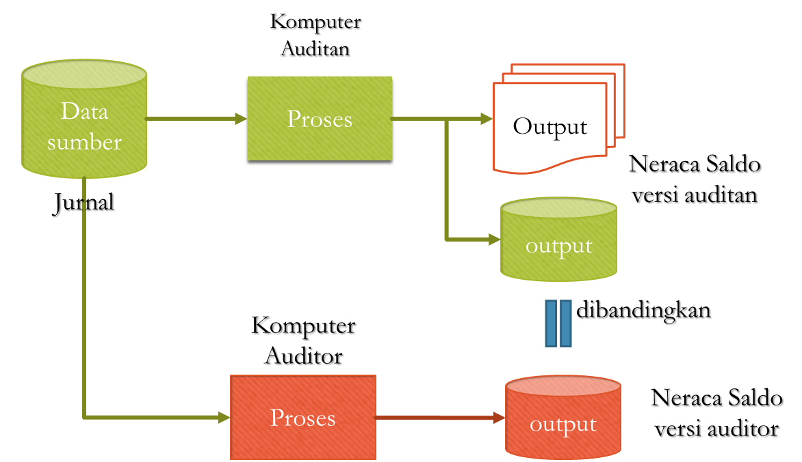
Parallel Simulation

Slide 12
Tahapan Pelaksanaan Audit Yang Telah Dipelajari (so far)
ToD
ToE
Simulasi Sejajar
Menguji pengendalian aplikasi
Menguji Validitas Data
Membuat Laporan Keuangan versi auditor

Slide 13
PRAKTIK

Slide 14
Group Up
LMS submission

Slide 15
More Challenges for Extra Credit (AKT)
Make a report for the whole 2025 data

Slide 16
Quiz Next Week :)

